Slide 1

Robo Rumble
“If debugging is the process of removing software bugs, then programming must be the process of putting them in.”
- Edsger Dijkstra

Slide 2
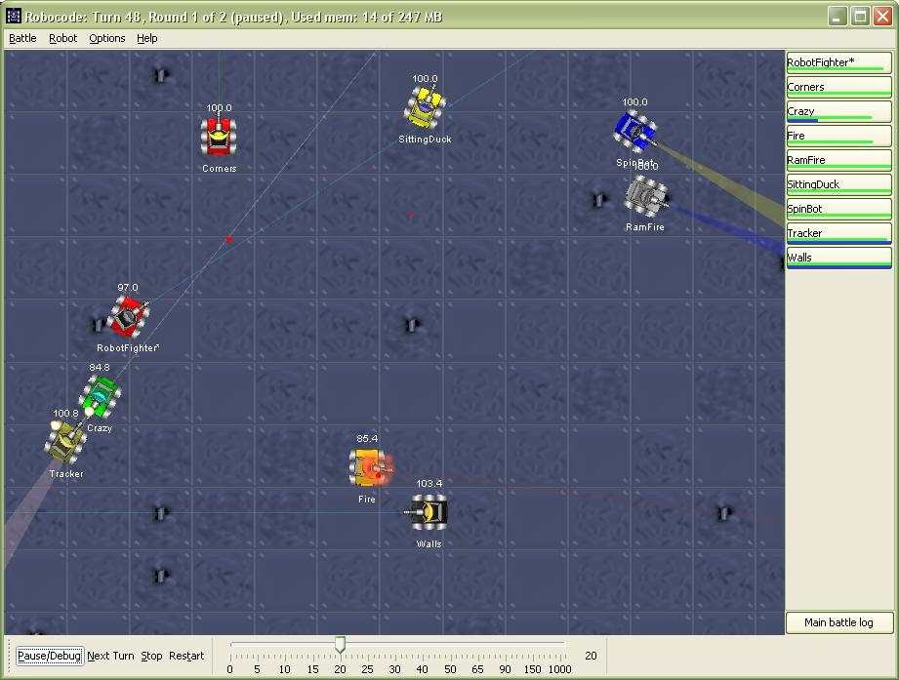
Gameplay
Royal Rumble
Everyone in battlespace, fight to the death!!!!!
PvP
Tournament, bracket based.
Winning Robots in each category get extra credit.

Slide 3
Bracket
T. Anderson (Apoc)___
|__ T. Anderson (Apoc)
A. Bamgbose(abiola)| |
|__ D. Escalera (RizzLord)|
S. Courtney_(mybots)_ | |
| D. Escalera (RizzLord)| |
D. Escalera (RizzLord)| |
|__ D. Escalera (RizzLord)| ___
Onur Genisel (Krampus) |
|_ Onur Genisel (Krampus) |
Jonathan Goohs_(GG)_| | Onur Genisel (Krampus) |
| | |
E. Haviland_(WarBot) _| |_ Onur Genisel (Krampus) |
|
D. Schrom_(dylan_Robot) |
| B.Wood_(WarBot)|
B.Wood_(WarBot)_ ___|

Slide 4
Prerequisites – java Development Kit (JDK)
Install Java 21
JDK vs OpenJDK
Linux (Ubuntu)
sudo apt-get install -y default-jdk
Mac
brew install openjdk@21
Windows
https://download.oracle.com/java/21/latest/jdk-21_windows-x64_bin.msi
Terminal Test:
java --version
javac --version

Slide 5
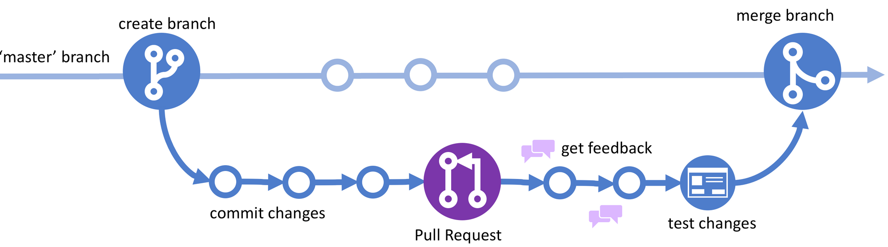
Collaborative github
1. Create Branch
2. Clone (if working locally)
3. Switch to branch
4. Edit
5. Commit the branch
6. Submit Pull Request
7. Review and Merge
8. Delete old branch

Slide 6
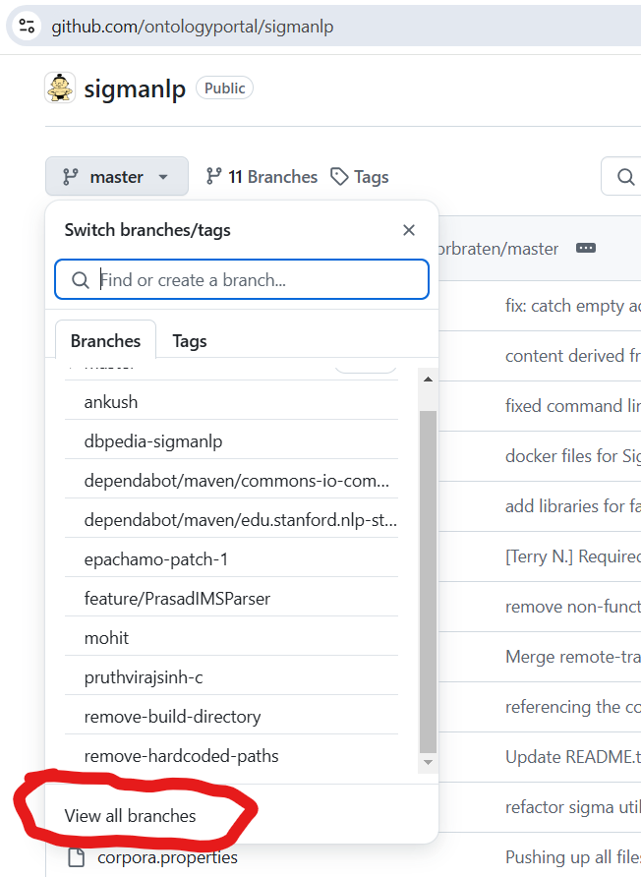
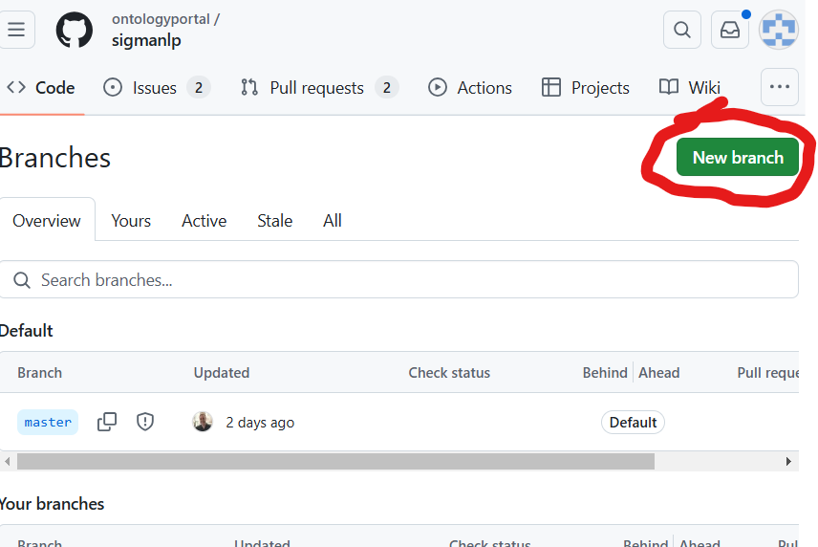
1. Create a new branch
https://github.com/epachamo/CS3022_robocode

Slide 7
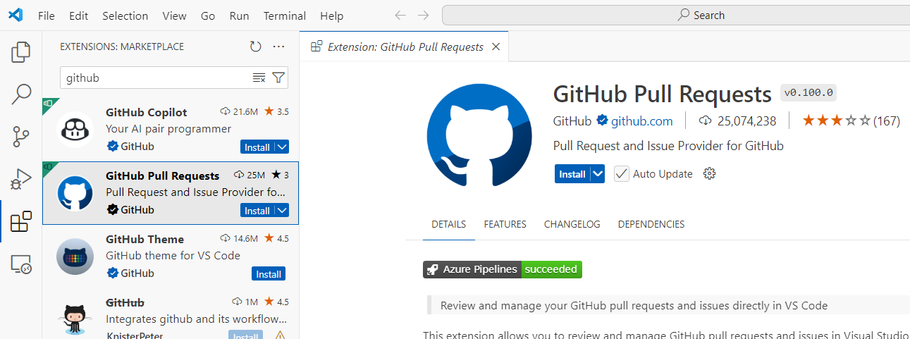
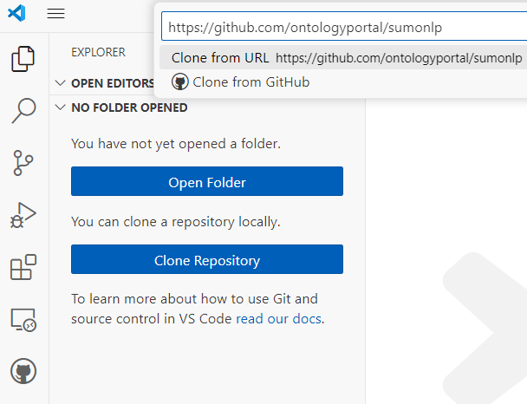
2. Clone

Slide 8
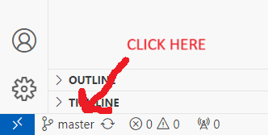
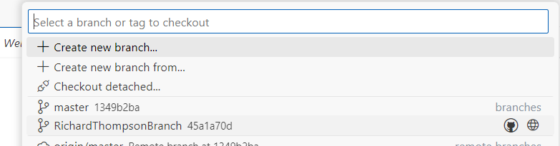
3. Switch to Branch
Click on master at the bottom left
Select your branch

Slide 9
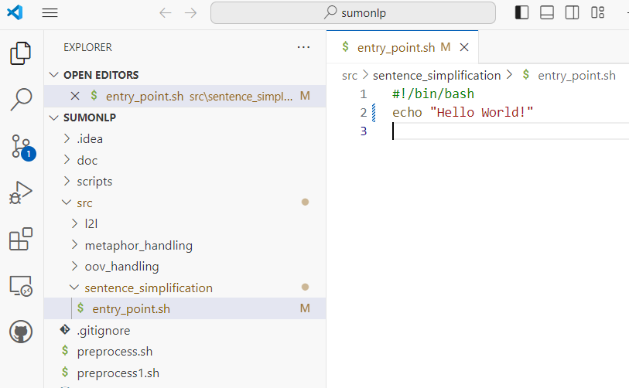
4. Make your edits

Slide 10
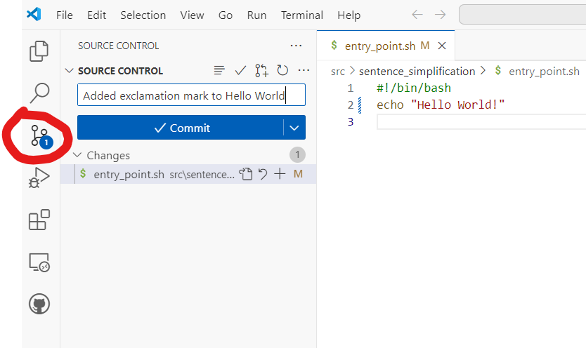
5. Commit the branch
This commits your changes to the branch, not to the master.

Slide 11
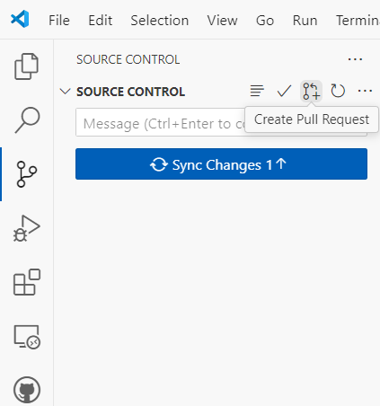
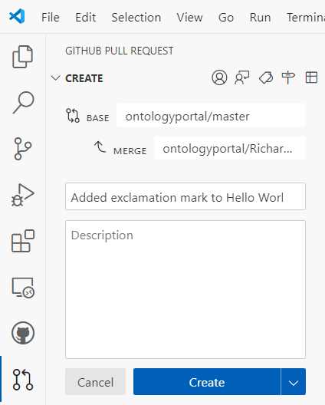
6. Submit Pull Request
After making several commits, submit a pull request. This request is made to the owner of the master branch, asking to merge changes into the master branch.

Slide 12

7. Review and Merge
CDR Thompson will review, and then merge your changes into the Main Branch.

Slide 13
Download and install robocode
Download robocode: https://sourceforge.net/projects/robocode/files/robocode/1.10.0/
In a terminal, navigate to download and run: java -jar robocode-1.10.0-setup.jar

Slide 14
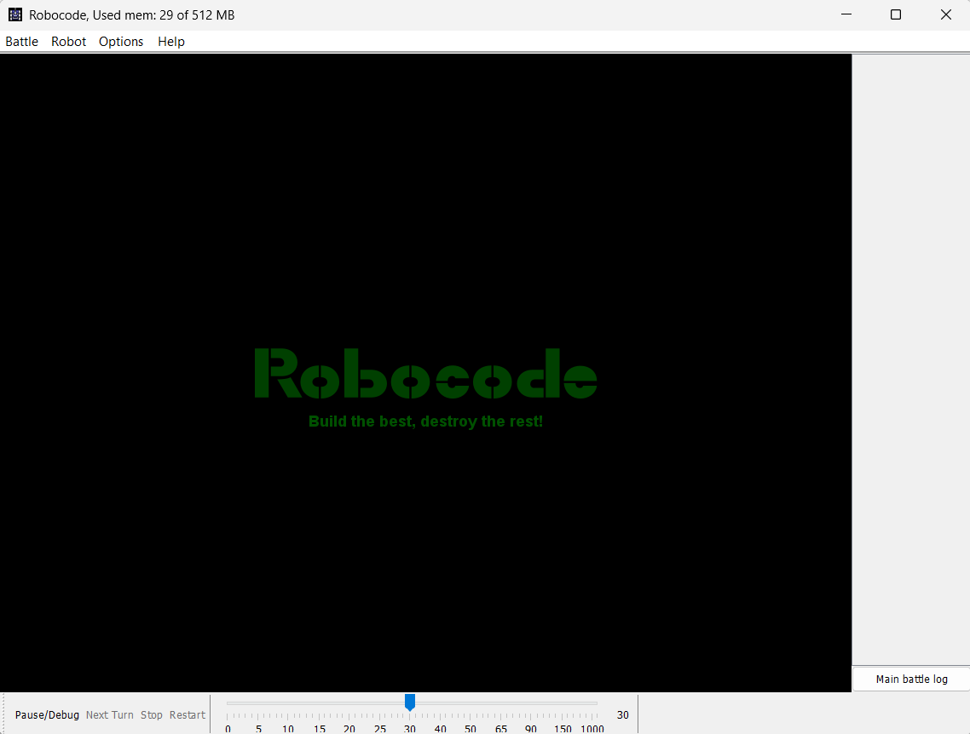
Run robocode
* run robocode.bat, or robocode.sh
* Here you can start a new battle. Its fun! Experiment with the interface, and test various robots against each other.
* Build a new robot:
Robot -> Source Editor
File -> New -> Robot

Slide 15
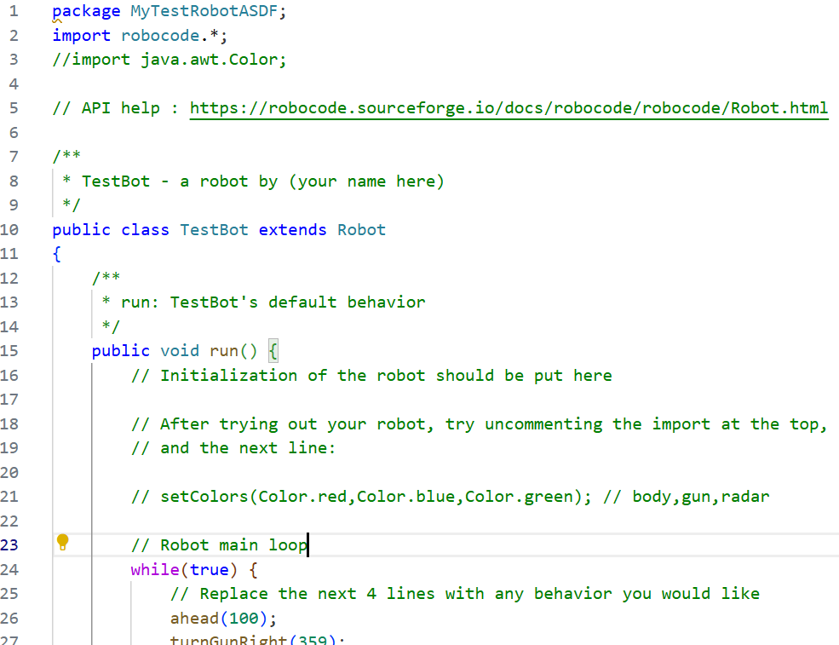
New Robot
Notice:
Our new class extends Robot
Open
robocode/javadoc/index.html
Find the Robot class from the “All Classes” list.
Observe the majesty of all the methods you have at your disposal.
Because you ‘extends’ this Robot class, you automatically get all of these methods. You can over-ride them to do what you want though.

Slide 16
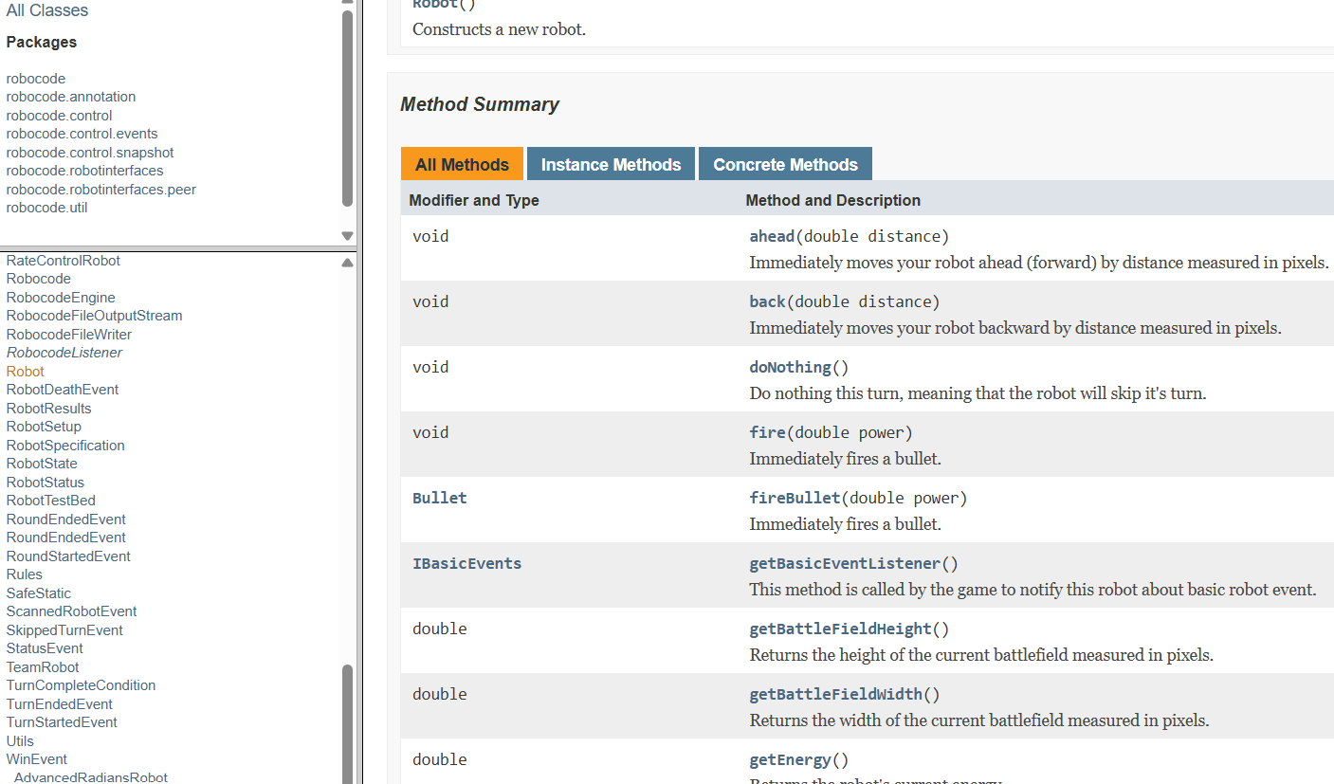
Robot class
Because you ‘extends’ this Robot class, you automatically get all of these methods. You can over-ride them to do what you want though.
You can override any of these methods. The default action for most is lame.
Other classes help you interact with the game and might be useful.
onHitRobot for example

Slide 17
Example
Note: HitRobotEvent is its own Object with methods such as ‘getBearing()’.
void onHitRobot(HitRobotEvent event) {
if (event.getBearing() > -90 && event.getBearing() <= 90) {
back(100);
} else {
ahead(100);
}
}

Slide 18
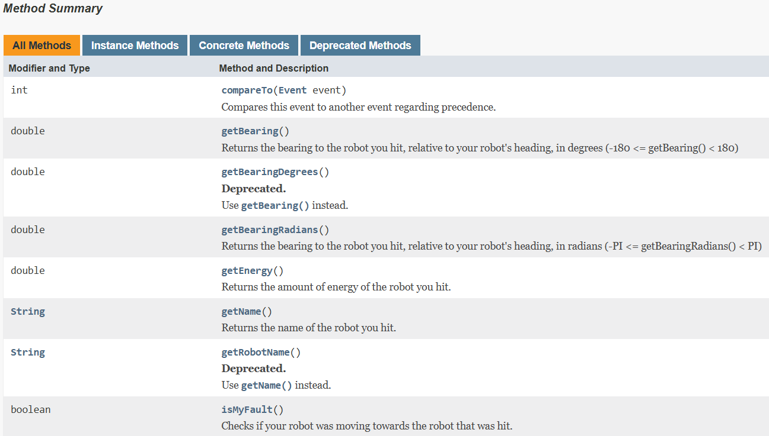
Hitrobotevent methods

Slide 19
resources
* Robocode homepage: https://robocode.sourceforge.io/
* RoboWiki: https://robowiki.net/wiki/Main_Page

Slide 20
rules
- Do NOT use AI for your algorithm. This totally defeats the purpose and will make it not fun.
- Do NOT simply copy a sample robot. You can get ideas from these robots, but you must add creative aspects.
- Spend at least 10 hours developing your robot.

Slide 21
deliverables
* Pull request
* Email to richard.thompson@nps.edu
* Tell me the name of the robot you wish to enter into the competition.
* Provide an explanation of your algorithm for success.
* The statement: “I (state your name) did not use AI to generate the algorithm for my robot. I spent at least 10 hours on this project.”

